Slide 1
Maps and Wayfinding
EDC&I 583
Message Design
25 January 2012

Slide 2
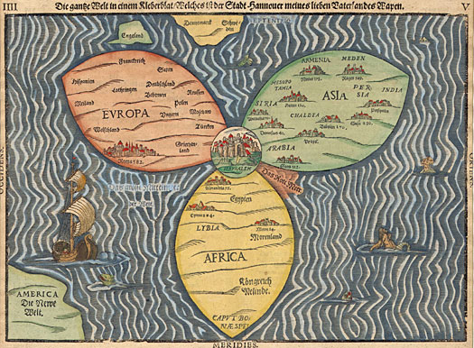
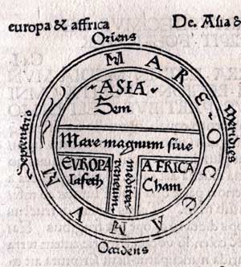
Earliest Maps
Ancient form of representing location and direction
What we think of as “typical” conventions arose only in last 400-500 years
“Yes, but how to I get from Paris to Frankfurt?”

Slide 3
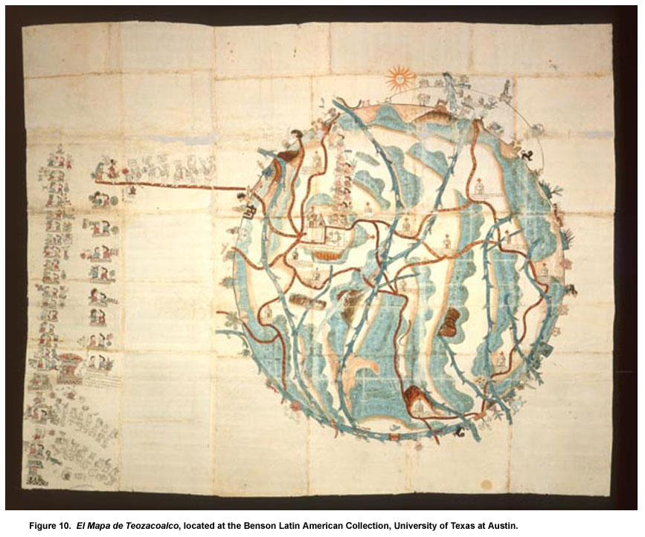
Emergence of Conventions
El Mapa de Teozacoalco, drawn about 1580
conventions from both European map-making and Mixtec codex-painting

Slide 4
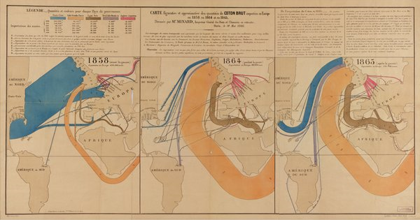
Maps and Data
A development of the late 18th – 19th c.
Minard’s Napoleon’s Retreat map; other ways of connecting aspects of data with location, direction, duration, etc.
Europe Raw Cotton Imports, 1858, 1864, 1865

Slide 5
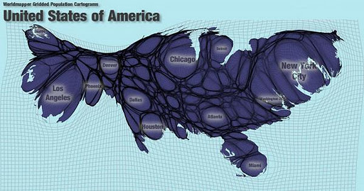
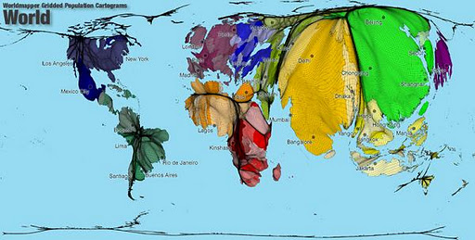
Changing What Scale Means
USA mapped by population density
World mapped by population density

Slide 6
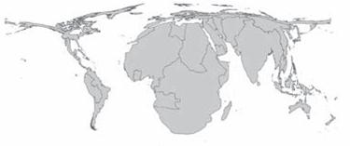
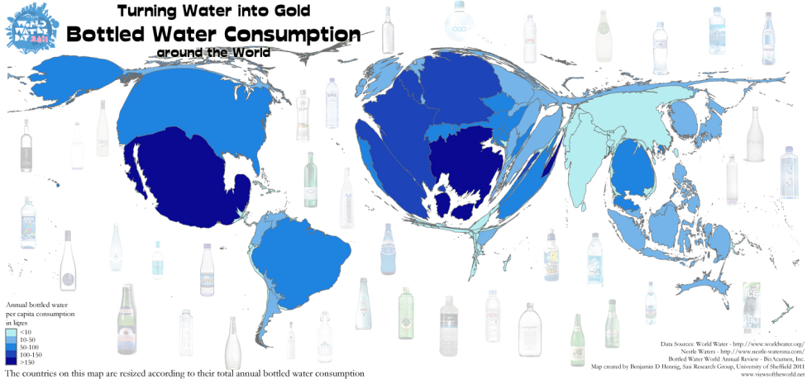
WHO estimates of per capita mortality from late 20th century climate change
Bottled water consumption per capita

Slide 7
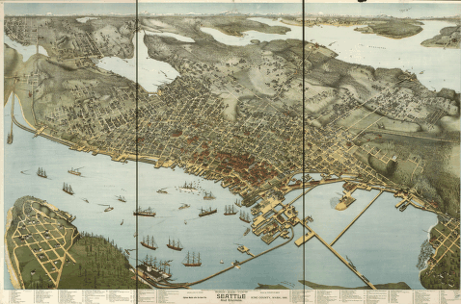
Maps and Mental Images
Aerial views before there were airplanes (or even dirigibles!)
Bird's-eye map of Seattle in 1891

Slide 8
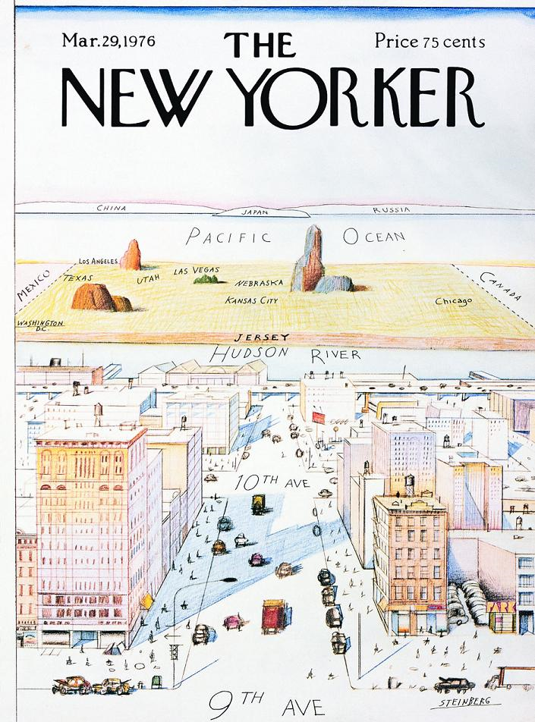
How We Think the World Is
The World as Seen from New York's 9th Avenue
Courtesy of Saul Steinberg

Slide 9
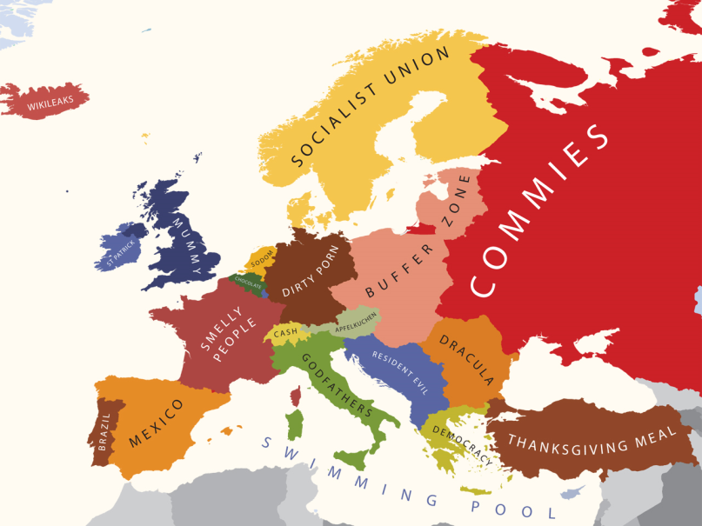
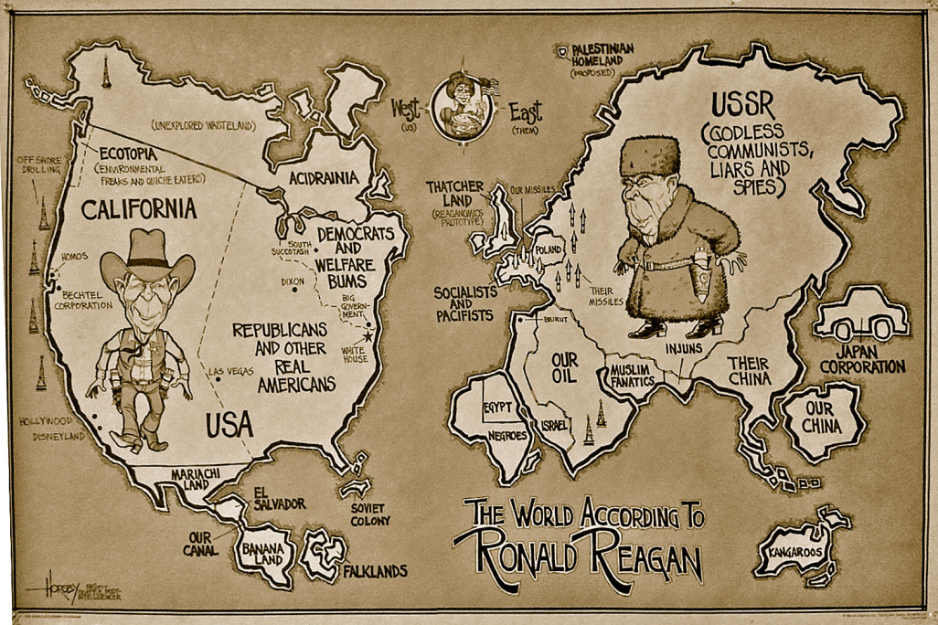
Whose View?
Prejudices can easily come to the fore …
Europe, as viewed by Americans
Reagan’s View of the World (per David Horsey)

Slide 10
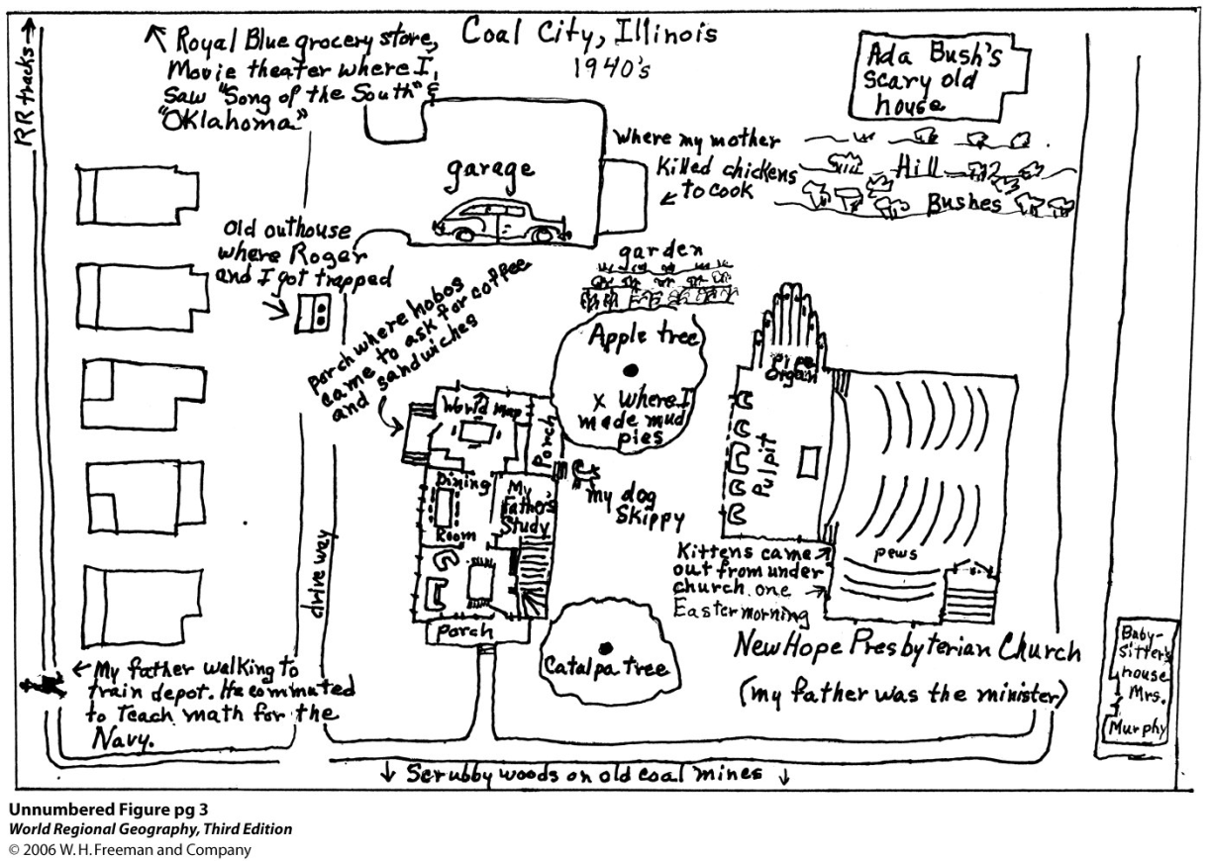
Research on Mental Constructs
How do people think about “their world”?
What emotional reactions attach to places?
How do imagined and real distances compare?

Slide 11
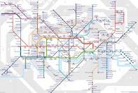
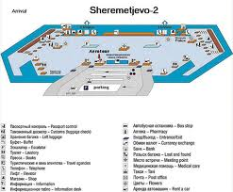
Wayfinding
Increasing issue, esp. in contexts with multi-lingual users
Frequent use of isotype (and related) symbols
Challenges and problems in design

Slide 12
Isotype
Development of the isotype approach
Increasing variety of symbols
Some problems communicating actions, abstract concepts

Slide 13
Pictogram Ideogram Communication
More focus on actions, processes
Efforts to create a “syntax” of actions, places, etc.
Still not an exact science

Slide 14
Stickman
How come it took so long for people to see the opportunities for parody?
(Courtesy of Archie McPhee)

Slide 15
Will They Understand Us?
Plaque on board Pioneer 10 (launched in 1972)
Developed by Carl Sagan
Critiques: Too anthropocentric?

Slide 16
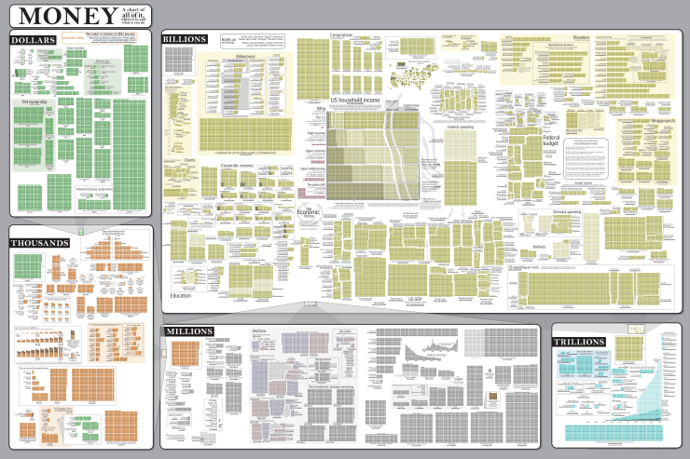
Online Wayfinding in Complex Graphics
This thing is so huge; where am I?
Use of inset “corner maps” to show location in larger graphic

Slide 17
Questions to Discuss
[Tufte ch. 2] Snow and the Broad St. pump: Have you been in a situation where you realized that mapping data would be a good solution? Did you do it? Did it work? Did others agree?
[Koyama] Pictogram/Isotype communication – Have you been in a setting where these approaches helped in cross-cultural/multi-lingual communication? Was everything comprehensible?
[Hahn] Your experience in learning to use a library (or comparable institution)?

Slide 18
Next Time: Review of Literature
Things to focus on when choosing studies/articles:
Quality of the journal/source
Quality of the study resign
Clarity, relevance of findings
Reputational validity
Author(s), institution/lab/center, prior research, etc.
Article summaries: Make them brief!

